Slide 1
NYC Payroll Data Integration Project
Presented by
Okpara Kenneth Chinonso
Data Engineering @ 10Alytics 2024

Slide 2
INTRODUCTION
The City of New York is embarking on a project to integrate payroll data across all its agencies in order to achieve below objectives: and would like to develop a Data Analytics platform to accomplish two primary objectives:
Analyze financial resource allocation overtime.
Improve transparency and public accessibility of the City Budget
Develop an efficient Data Analytics platform

Slide 3
PROJECT OBJECTIVES
Design a Data Warehouse for NYC
Develop a scalable and automated ETL Pipeline to load the payroll data into the data warehouse
Ensure quality and consistency of data in your pipeline
Create a public user with limited privileges to enable public access to the NYC Data warehouse

Slide 4
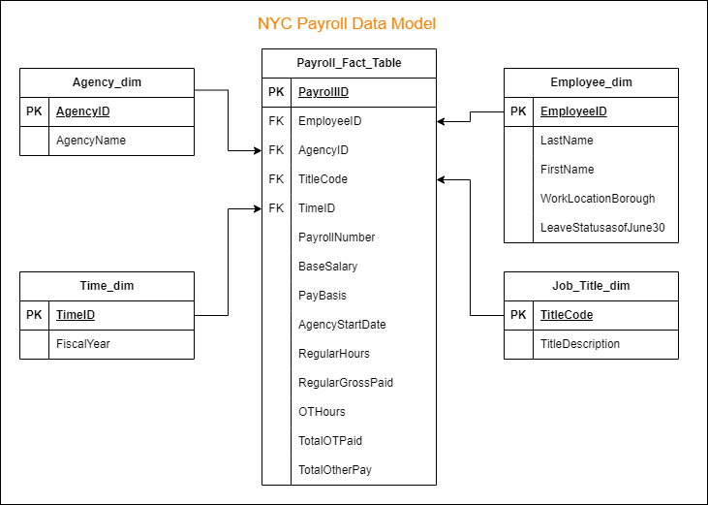
Data Warehouse Design for NYC

Slide 5
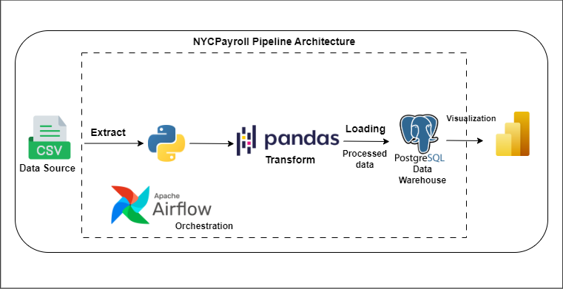
ETL DATA ARCHITECTURE

Slide 6
ETL Pipeline Overview
Extraction: Retrieve payroll and Master data from CSV files stored in a remote directory.
Transformation: Clean, standardize, and merge datasets to ensure consistency and accuracy.
Loading: Load the processed data into a PostgreSQL data warehouse for storage and analysis.
Orchestration: Use Apache Airflow to efficiently automate and monitor the pipeline execution.

Slide 7
TECHNOLOGY STACKS USED
Python: Was used for the ETL pipeline scripting due to its simplicity and vast ecosystem of libraries.
Pandas: Was essential for the data manipulation and transformation.
PostgreSQL: Was used for data storage relational database that ensures efficient storage and querying of structured data.
Psycopg2 & StringIO: Used to interact with database allowing direct execution of SQL commands within Python scripts.
Apache Airflow (Orchestration): Was used for the automation, scheduling, and monitoring of the ETL pipeline.
GitHub: Version control and documentation.

Slide 8
Optimization Recommendations For NYC
Leverage Apache Spark for large-scale transformations instead of Pandas.
Use cloud-based data warehouses (e.g., Snowflake, BigQuery, or Amazon Redshift) for scalability.
Optimize SQL queries by implementing indexing and partitioning strategies.
Schedule data pipeline executions during off-peak hours to reduce system load.

Slide 9
Conclusion
In this project I was able to design and implement a payroll data pipeline to efficiently process and analyze payroll records of NYC. Using Pandas, raw payroll data from CSV files was cleaned, transformed, and prepared for loading. The transformed data was then stored in a PostgreSQL data warehouse for structured querying and reporting. Apache Airflow was utilized to orchestrate the entire pipeline, automating data extraction, transformation, and loading (ETL) processes.

Slide 10
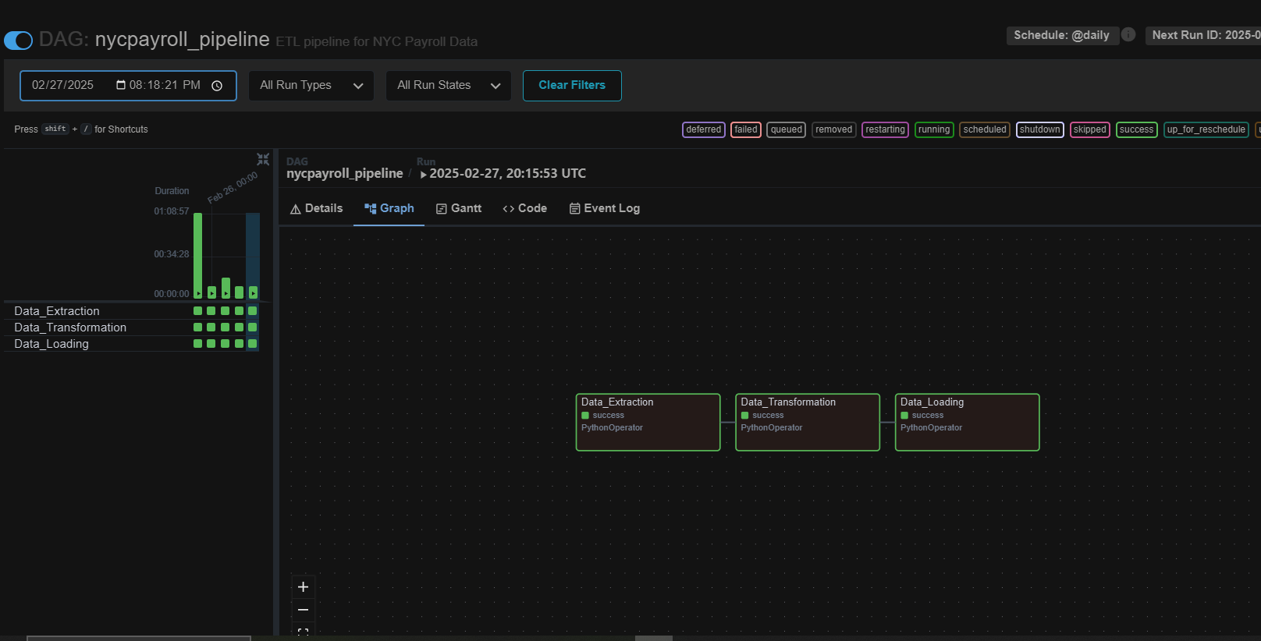
Apache Airflow Orchestration

Slide 11
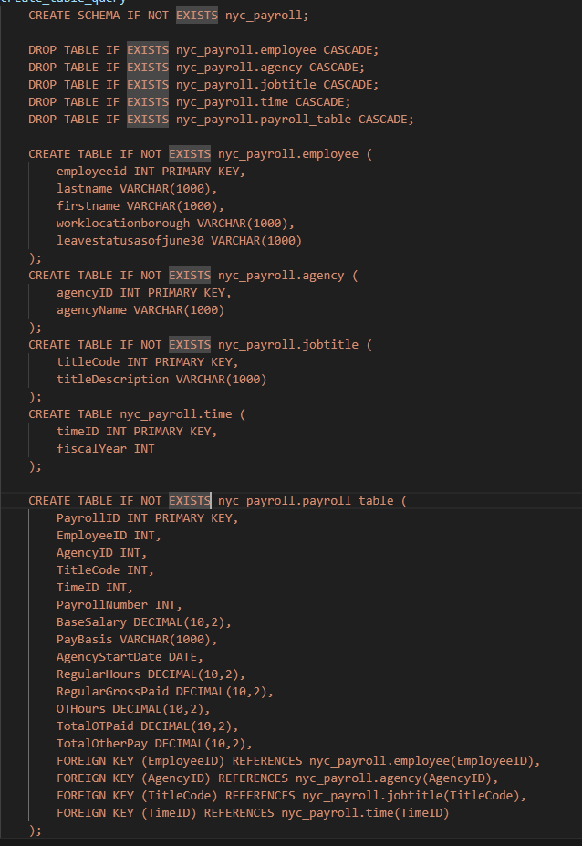
Data Warehouse Schema

Slide 12
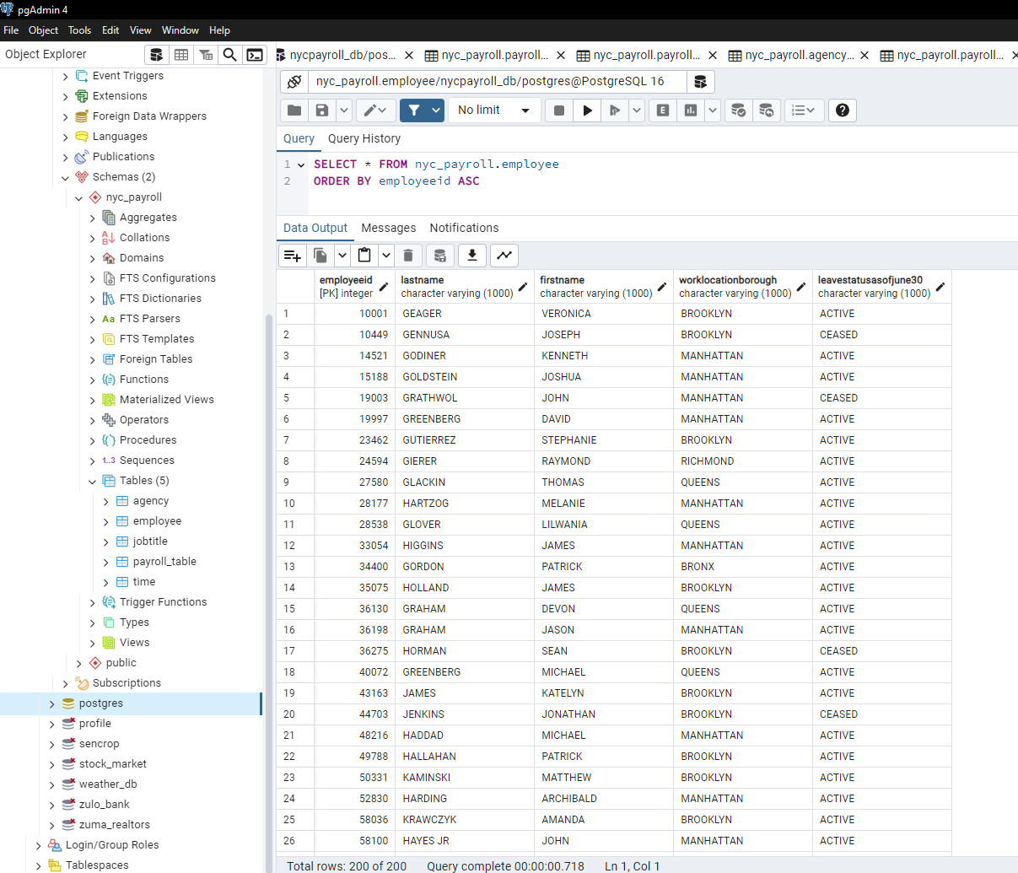
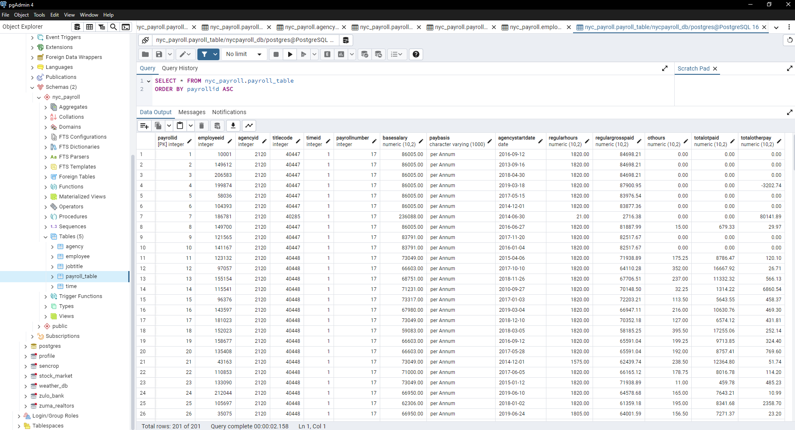
PostgreSQL Data Warehouse

Slide 13
Thank You

